Slide 1

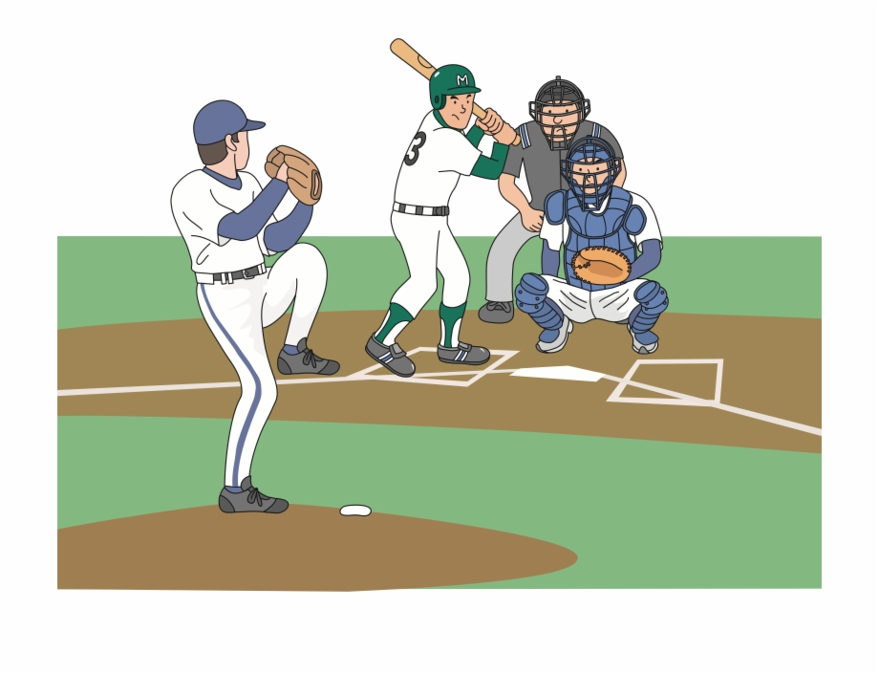
A Brief Intro to Baseball
Pitch = Ball or Strike
4 Balls = Walk
3 Strikes = Out
3 Outs per Inning (per Team)
9 Innings per Game

Slide 2


A Brief Intro to Baseball
Getting a hit/walk puts the batter on base
$$×$$

Slide 3

A Brief Intro to Baseball
Getting a hit/walk puts the batter on base
Another hit/walk or base steal can advance the runner
$$×$$

Slide 4

A Brief Intro to Baseball
Getting a hit/walk puts the batter on base
Another hit/walk or base steal can advance the runner
Making it home earns a run
$$×$$

Slide 5
A Brief Intro to Baseball
Getting a hit/walk puts the batter on base
Another hit/walk or base steal can advance the runner
Making it home earns a run
The team with the most runs after 9 innings wins
$$×$$

Slide 6
What Makes a Winning Baseball Team?
Win
Score Runs Against Opponent
Stop Opponent From Scoring Runs

Slide 7
What Makes a Winning Baseball Team?
Score Runs Against Opponent
Get On Base

Slide 8
What Makes a Winning Baseball Team?
Get On Base
Walks
Hit by Pitch
Hits
Single
Double
Triple
Home Run

Slide 9
On Base Percentage
Get On Base
Walks
Hit by Pitch
Hits
Single
Double
Triple
Home Run

Slide 10

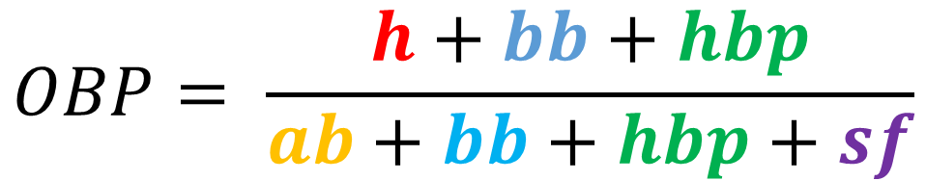



On Base Percentage
$$OBP= \frac{h+bb+hbp}{ab+bb+hbp+sf}$$
$$h≔\# of Hits$$
$$ab≔\# of At Bats$$
$$bb≔\# of Walks$$
$$sf≔\# of Sacrifice Flies$$
$$hbp≔\# of Times Hit By Pitch$$

Slide 11
Slugging Percentage
Get On Base
Walks
Hit by Pitch
Hits
Single
Double
Triple
Home Run

Slide 12

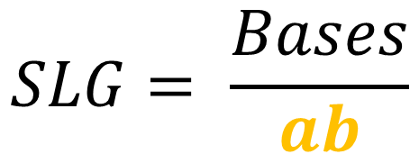




Slugging Percentage
$$SLG= \frac{Bases}{ab}$$
$$Bases=s+2d+3t+4hr$$
$$s≔\# of Singles$$
$$ab≔\# of At Bats$$
$$d≔\# of Doubles$$
$$t≔\# of Triples$$
$$hr≔\# of Home Runs$$

Slide 13
What Makes a Winning Baseball Team?
Stop Opponents From Scoring Runs

Slide 14
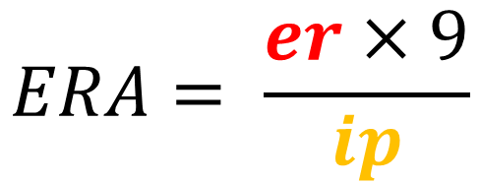


Earned Run Average
$$ERA= \frac{er×9}{ip}$$
$$er≔\# of Earned Runs$$
$$ip≔\# of Innings Pitched$$

Slide 15


Moneyball

